Slide 1
Chapter 5: Information Retrieval and Web Search
An introduction

Slide 2
Data Mining
Data Mining (sometimes called data or knowledge discovery) is the process of analysing data from different perspectives and summarizing it into useful information.
The process of Data Mining fundamentally consists of three stages:
data preparation
mining operation
Results presentation and explanation

Slide 3

Knowledge Discovery Process
  Data mining: the core of knowledge discovery process.
Knowledge Interpretation
Data Mining
Task-relevant Data
Data transformations
Preprocessed Data
Selection
Data Cleaning
Data Integration
Databases

Slide 4
Introduction
Text mining refers to data mining using text documents as data.
Most text mining tasks use Information Retrieval (IR) methods to pre-process text documents.
These methods are quite different from traditional data pre-processing methods used for relational tables.
Web search also has its root in IR.

Slide 5
Information Retrieval (IR)
Conceptually, IR is the study of finding needed information. I.e., IR helps users find information that matches their information needs.
  Expressed as queries
Historically, IR is about document retrieval, emphasizing document as the basic unit.
  Finding documents relevant to user queries
Technically, IR studies the acquisition, organization, storage, retrieval, and distribution of information.

Slide 6
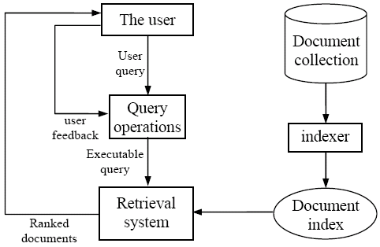
IR architecture

Slide 7
IR queries
Keyword queries
Boolean queries (using AND, OR, NOT)
Phrase queries
Proximity queries
Full document queries
Natural language questions

Slide 8
Information retrieval models
An IR model administrates how a document and a query are represented and how the relevance of a document to a user query is defined.
Main models:
  Boolean model
  Vector space model
  Statistical language model

Slide 9
Boolean model
Each document or query is treated as a “bag” of words or terms. Word sequence is not considered.
Given a collection of documents D, let V = {t₁, t₂, ..., t_{|V|}} be the set of distinctive words/terms in the collection. V is called the vocabulary.
A weight w_{ij} > 0 is associated with each term t_{i} of a document d_{j} ∈ D. For a term that does not appear in document d_{j}, w_{ij} = 0.
d_{j} = (w_{1j}, w_{2j}, ..., w_{|V|j}),

Slide 10
Boolean model (contd)
Query terms are combined logically using the Boolean operators AND, OR, and NOT.
  E.g., ((data AND mining) AND (NOT text))
Retrieval
  Given a Boolean query, the system retrieves every document that makes the query logically true.
  Called exact match.
The retrieval results are usually quite poor because term frequency is not considered.

Slide 11
Vector space model
Documents are also treated as a “bag” of words or terms.
Each document is represented as a vector.
However, the term weights are no longer 0 or 1. Each term weight is computed based on some variations of TF or TF-IDF scheme.
Term Frequency (TF) Scheme: The weight of a term t_{i} in document d_{j} is the number of times that t_{i} appears in d_{j}, denoted by f_{ij}. Normalization may also be applied.

Slide 12



TF-IDF term weighting scheme
The most well known weighting scheme
  TF: still term frequency
  IDF: inverse document frequency.
  N: total number of docs
  df_{i}: the number of docs that t_{i} appears.
The final TF-IDF term weight is:

Slide 13

Retrieval in vector space model
Query q is represented in the same way or slightly differently.
Relevance of d_{i} to q: Compare the similarity of query q and document d_{i}.
Cosine similarity (the cosine of the angle between the two vectors)
Cosine is also commonly used in text clustering

Slide 14
An Example
A document space is defined by three terms:
  hardware, software, users
  the vocabulary
A set of documents are defined as:
  A1=(1, 0, 0), A2=(0, 1, 0), A3=(0, 0, 1)
  A4=(1, 1, 0), A5=(1, 0, 1), A6=(0, 1, 1)
  A7=(1, 1, 1) A8=(1, 0, 1). A9=(0, 1, 1)
If the Query is “hardware and software”
what documents should be retrieved?

Slide 15
An Example (cont.)
In Boolean query matching:
  document A4, A7 will be retrieved (“AND”)
  retrieved: A1, A2, A4, A5, A6, A7, A8, A9 (“OR”)
In similarity matching (cosine):
  q=(1, 1, 0)
  S(q, A1)=0.71, S(q, A2)=0.71, S(q, A3)=0
  S(q, A4)=1, S(q, A5)=0.5, S(q, A6)=0.5
  S(q, A7)=0.82, S(q, A8)=0.5, S(q, A9)=0.5
  Document retrieved set (with ranking)=
    {A4, A7, A1, A2, A5, A6, A8, A9}

Slide 16
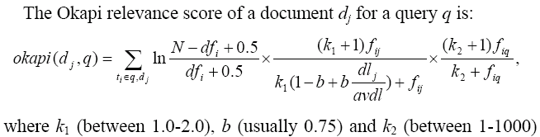
Okapi relevance method
Another way to assess the degree of relevance is to directly compute a relevance score for each document to the query.
The Okapi method and its variations are popular techniques in this setting.

Slide 17

Relevance feedback
Relevance feedback is one of the techniques for improving retrieval effectiveness. The steps:
  the user first identifies some relevant (D_{r}) and irrelevant documents (D_{ir}) in the initial list of retrieved documents
  the system expands the query q by extracting some additional terms from the sample relevant and irrelevant documents to produce q_{e}
  Perform a second round of retrieval.
Rocchio method (α, β and γ are parameters)

Slide 18

Rocchio text classifier
In fact, a variation of the Rocchio method above, called the Rocchio classification method, can be used to improve retrieval effectiveness too
  so are other machine learning methods. Why?
Rocchio classifier is constructed by producing a prototype vector c_{i} for each class i (relevant or irrelevant in this case):
In classification, cosine is used.

Slide 19
Text pre-processing
Word (term) extraction: easy
Stopwords removal
Stemming
Frequency counts and computing TF-IDF term weights.
Notes:
4

Slide 20
Stopwords removal
Many of the most frequently used words in English are useless in IR and text mining – these words are called stop words.
  the, of, and, to, ….
  Typically about 400 to 500 such words
  For an application, an additional domain specific stopwords list may be constructed
Why do we need to remove stopwords?
  Reduce indexing (or data) file size
    stopwords accounts 20-30% of total word counts.
  Improve efficiency and effectiveness
    stopwords are not useful for searching or text mining
    they may also confuse the retrieval system.

Slide 21
Stemming
Techniques used to find out the root/stem of a word. E.g.,
      user engineering
      users engineered
      used engineer
      using
stem: use engineer
Usefulness:
improving effectiveness of IR and text mining
  matching similar words
  Mainly improve recall
reducing indexing size
  combing words with same roots may reduce indexing size as much as 40-50%.

Slide 22
Basic stemming methods
Using a set of rules. E.g.,
remove ending
  if a word ends with a consonant other than s,
  followed by an s, then delete s.
  if a word ends in es, drop the s.
  if a word ends in ing, delete the ing unless the remaining word consists only of one letter or of th.
  If a word ends with ed, preceded by a consonant, delete the ed unless this leaves only a single letter.
  …...
transform words
  if a word ends with “ies” but not “eies” or “aies” then “ies --> y.”

Slide 23
Frequency counts + TF-IDF
Counts the number of times a word occurred in a document.
  Using occurrence frequencies to indicate relative importance of a word in a document.
    if a word appears often in a document, the document likely “deals with” subjects related to the word.
Counts the number of documents in the collection that contains each word
TF-IDF can be computed.

Slide 24
Evaluation: Precision and Recall
Given a query:
  Are all retrieved documents relevant?
  Have all the relevant documents been retrieved?
Measures for system performance:
  The first question is about the precision of the search
  The second is about the completeness (recall) of the search.

Slide 25
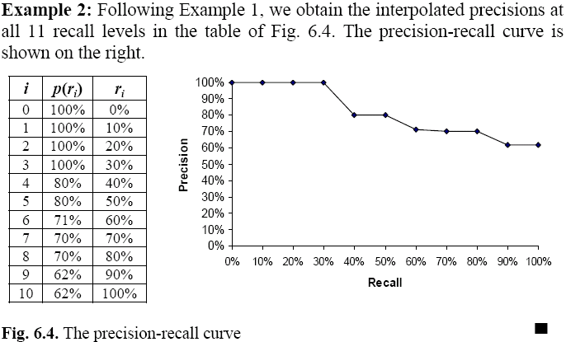
Precision-recall curve

Slide 26
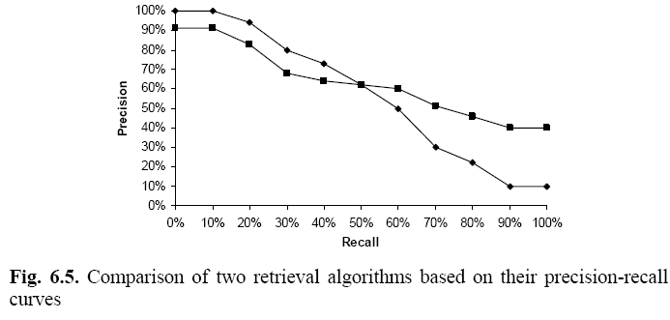
Compare different retrieval algorithms

Slide 27
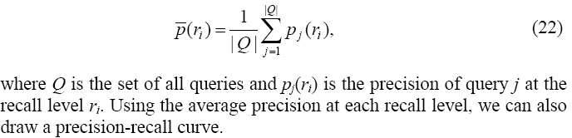
Compare with multiple queries
Compute the average precision at each recall level.
Draw precision recall curves
Do not forget the F-score evaluation measure.

Slide 28
Rank precision
Compute the precision values at some selected rank positions.
Mainly used in Web search evaluation.
For a Web search engine, we can compute precisions for the top 5, 10, 15, 20, 25 and 30 returned pages
  as the user seldom looks at more than 30 pages.
Recall is not very meaningful in Web search.
  Why?

Slide 29
Web Search as a huge IR system
A Web crawler (robot) crawls the Web to collect all the pages.
Servers establish a huge inverted indexing database and other indexing databases
At query (search) time, search engines conduct different types of vector query matching.

Slide 30
Inverted index
The inverted index of a document collection is basically a data structure that
  attaches each distinctive term with a list of all documents that contains the term.
Thus, in retrieval, it takes constant time to
  find the documents that contains a query term.
  multiple query terms are also easy handle as we will see soon.

Slide 31
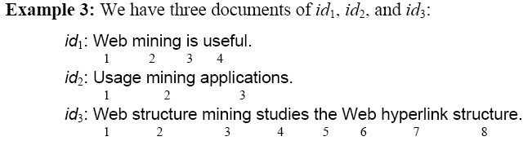
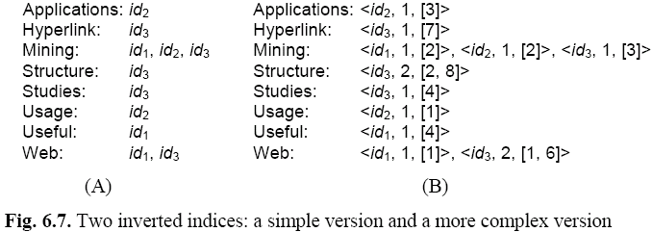
An example

Slide 32
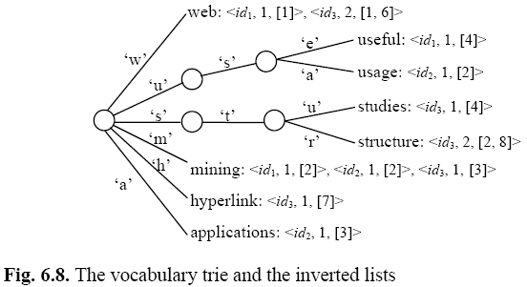
Index construction
Easy! See the example,

Slide 33
Search using inverted index
Given a query q, search has the following steps:
Step 1 (vocabulary search): find each term/word in q in the inverted index.
Step 2 (results merging): Merge results to find documents that contain all or some of the words/terms in q.
Step 3 (Rank score computation): To rank the resulting documents/pages, using,
  content-based ranking
  link-based ranking

Slide 34
Different search engines
The real differences among different search engines are
  their index weighting schemes
    Including location of terms, e.g., title, body, emphasized words, etc.
  their query processing methods (e.g., query classification, expansion, etc)
  their ranking algorithms
  Few of these are published by any of the search engine companies. They aretightly guarded secrets.

Slide 35
Summary
We only give a VERY brief introduction to IR. There are a large number of other topics, e.g.,
  Statistical language model
  Latent semantic indexing (LSI and SVD).
  (read an IR book or take an IR course)
Many other interesting topics are not covered, e.g.,
  Web search
    Index compression
    Ranking: combining contents and hyperlinks
  Web page pre-processing
  Combining multiple rankings and meta search
  Web spamming
Want to know more? Read the textbook

